Slide 1


5th Semester DBMS Mini Project
HOTEL IN-HOUSE BOOKING DATABASE MANAGEMENT SYSTEM
PRESENTED BY:
Kavyashree S 1DB19IS036
GUIDED BY:
Mr. Basavaraj N
Asst. Professor
Department of ISE
DBIT
GUIDED BY:
Mrs. Rohini B.R
Asst. Professor
Department of ISE
DBIT
Department of Information Science and Engineering
Don Bosco Institute of Technology, Mysore road, Kumbalagodu, Bangalore

Slide 2
AGENDA
INTRODUCTION
PURPOSE
AIM AND OBJECTIVE
USE CASE DIAGRAM OF HBMS
ENTITY DIAGRAM
SCHEMA DIAGRAM
CONCLUSION
REFERENCE

Slide 3
INTRODUCTION
The project, Hotel In-House Booking Management System is a desktop-based application that allows the hotel manager to handle all the hotel booking activities. The hotel manager is very busy person and does not have time to sit and manage the entire activities manually on paper. This application gives him the power and flexibility to manage the entire system from a single system. This project provides room booking for the customers and allows the manager to post available rooms and also the he can go through the check-in and check-out status and payment status of a customer.

Slide 4
PURPOSE
The main purpose of the project is to design and develop a user-friendly efficient computerized Hotel In-House Booking management system.
An accurate system without any data redundancy.
Storing the details of the customers.
Provides easy way of booking rooms.
Maintaining and updating customer account: generating bill, keeping track of transactions.
Secured data storage for authority end.
Provides secure, reliable and fast management system. Thus, it will help organization in better utilization of resources.

Slide 5
AIM AND OBJECTIVE
The main objective of this project is to manage the details of Hotel, Rooms, Services, Payments, Bookings. It manages all the information about Hotel, Customers, Bookings. The project is totally built at administrative end and thus only the administrator is guaranteed the access. The purpose of the project is to build an application program to reduce the manual work for managing the Hotel, Rooms, Customers. It tracks all the details about the Customers, Payments, and Bookings.

Slide 6
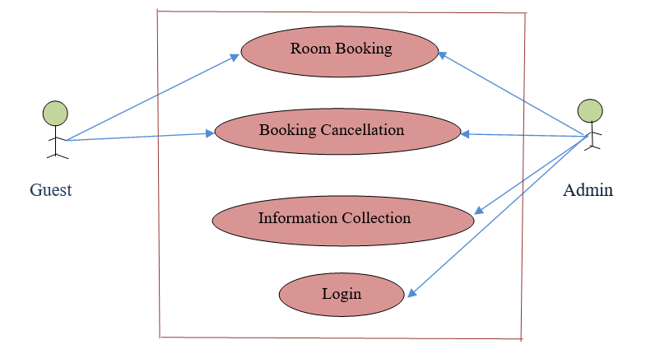
USE CASE DIAGRAM OF HBMS

Slide 7
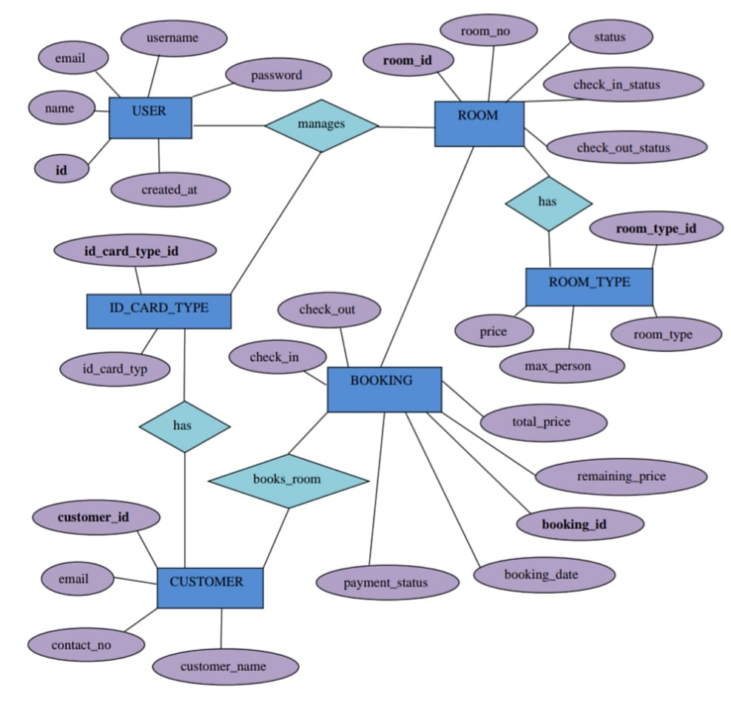
ENTITY DIAGRAM

Slide 8
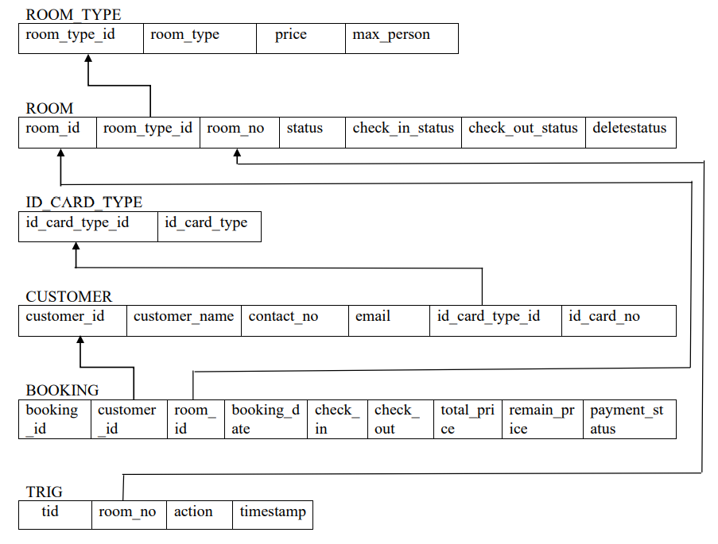
SCHEMA DIAGRAM

Slide 9
CONCLUSION
This is my first attempt in developing a desktop application, which gave me a basic understanding of development and challenges of web application development. The main aim of this project is to overcome the time required to search for any information and add mobility and automation to the process of managing customers and room’s information. This application has been implemented and tested on real devices.

Slide 10
REFERENCE
HTML, CSS: The Complete Reference, Fifth Edition
Learning PHP, MYSQL, JavaScript & Bootstrap
Website:
www.researchgate.com
www.simplilearn.com
www.codeastro.com
www.geeksforgeeks.org
www.iNetTutor.com

Slide 11
Thank You

